Slide 1
Comparative Analysis of Biomass Energy Yield: Stoichiometric Estimation vs. Real-World Plant Data
Om Panchal ( 1230694454)
Pradnesh Mhatre ( 1226479399)
Tanmay Pujari (1235900473)
Ravikiran Patil( 1235323962)

Slide 2
Objective
To compare theoretical vs. actual energy output of biomass fuels
Use stoichiometric combustion analysis for theoretical yield
Analyze real-world plant data (wood chips, rice husk, bagasse)
Identify efficiency gaps and major energy loss factors
Support optimization strategies for biomass-based energy systems
Notes:
1—> calculating the maximum possible energy output from biomass fuels based on their chemical composition using stoichiometric (ideal) combustion formulas.
it’s done:
• Using elemental analysis (percentages of C, H, O, S in biomass)
2—> Measure how much energy biomass plants actually produce compared to the theoretical values calculated earlier.
🛠️ How it’s done:
• Gather plant data on electricity output and fuel input
• Calculate actual energy output per kg of biomass
• Compare it with HHV/LHV-based theoretical values
4—>4 Identify Efficiency Gaps and Energy Loss Factors
Determine why the actual energy output is lower than expected and what factors cause these losses.
4. Evaluate Economic Performance via Levelized Cost of Electricity (LCOE)
Analyze the cost of producing electricity from biomass across the plant’s lifetime, factoring in investment, fuel cost, O&M, and energy output.
5. Make Recommendations for Optimizing Biomass Energy Systems
Use insights from technical and economic analysis to propose ways to improve performance, reduce losses, and lower generation costs.

Slide 3
Expected Outcomes
Yield values for 3 biomass types
Real-world thermal efficiency comparison
Key energy losses identified
Graphs for visualization
Final energy efficiency summary (%)
Practical recommendations
Notes:
✅ Expected Outcomes – Explained
⸻
1. Yield Values for 3 Biomass Types
“We will calculate the theoretical energy content (in MJ/kg) of three biomass fuels using their elemental composition. This tells us how much energy each type can produce under perfect combustion.”
⸻
2. Real-World Thermal Efficiency Comparison
“We will compare the above theoretical energy values with what actual biomass plants produce in the real world. Due to energy losses, only less amount theoretical energy is usually converted into usable electricity.”
⸻
3. Key Energy Losses Identified
“We will identify why the actual energy is much lower than the calculated values. These losses include:”
• Moisture evaporation from wet biomass
• Unburned carbon in ash
• Heat lost in flue gases
These are the reasons for the gap between potential and reality.
⸻
4. Graphs for Visualization
“We will create bar graphs, pie charts, and other visuals to show comparisons of:”
• Theoretical vs Real Energy
• Energy loss breakdown
• LCOE comparison by biomass type

Slide 4
Literature Review
IRENA & ETSAP (2015)
ERIA Thailand Report (2019):
Explained global biomass potential, combustion technologies, and the importance of fuel pre-treatment.
Analyzed biomass feedstock cost variations, FiT policies, and calculated LCOE for power plants in Southeast Asia.
Biomass Energy Data Book:
IEA Bioenergy Reports:
Provided ultimate analysis data (C, H, O, S content), HHV/LHV values, and plant performance metrics for different biomass types.
Real-world efficiency benchmarks and operational challenges of biomass-based plants.
Notes:
1. ✅ IRENA & ETSAP (2015) – Technology Brief E05: Biomass for Heat and Power
📌 What It Contains:
• Detailed analysis of biomass combustion technologies, including direct combustion, gasification, and CHP.
• Information on technical performance (efficiency, emissions).
• Comparison of different feedstocks (wood, rice husk, bagasse).
• Emphasizes pre-treatment importance (drying, pelletizing).
• Gives global benchmarks for conversion efficiency and technology cost trends.
• its explanation of pre-treatment methods like drying to explain energy loss reduction.
⸻
2. ✅ ERIA Thailand Report (2019) – Renewable Energy Outlook
📌 What It Contains:
• Southeast Asia–focused data on biomass energy economics.
• Provides real-world LCOE calculations for various feedstocks (wood chips, rice husk, bagasse).
• Details CAPEX values, O&M costs, FiT policies (Feed-in Tariffs).
• Shows the economic potential of small- and medium-scale biomass plants.
• Include mention of Thailand’s location-based FiT incentive as a real-world policy model
⸻
3. ✅ Biomass Energy Data Book – Edition 3 (DOE)
📌 What It Contains:
• U.S.-based comprehensive dataset on biomass resources, energy content, and fuel properties.
• Tables of ultimate analysis (C, H, O, N, S), HHV, LHV for different feedstocks.
• Covers moisture content, ash content, and bulk density — all key for combustion modeling.
• Includes data on biomass supply chains and logistics.
🎯 How to Use in Your Project:
• Use HHV/LHV from here for stoichiometric calculations
⸻
4. ✅ IEA Bioenergy Reports
📌 What It Contains:
• Case studies of operating biomass power plants in different countries
• Insights into real-world challenges: fuel availability, efficiency losses, maintenance issues
• Data on conversion efficiency, environmental impacts, and best practices
• Policy suggestions for improving biomass adoption

Slide 5
Bio-Mass Selected
Wood Chips
Rice Husk
Bagasse
High HHV (~19 MJ/kg)
Common in temperate regions
Expensive and bulky
Agro-waste from rice mills
Lower HHV (~15.5 MJ/kg)
Lightweight, abundant in Asia
Byproduct of sugar industry
Moderate HHV (~17.5 MJ/kg)
Low cost, available near mills

Slide 6
Calculation
Let us see how we proceed with the calculation

Slide 7
Stoichiometric Energy Estimation
Basic empirical Formula
C_{x}H_{y}O_{z}N_{a}S_{b} Combustion reaction estimates O₂ and energy yield
Combustion Reaction
C_{x}H_{y}O_{z}N_{a}S_{b} + O₂ → _{x}CO₂+ y/2 H₂O + _{a}NO₂ + _{b}SO₂
Notes:
“This is a simplified chemical recipe of what happens when biomass (plant-based fuel) burns in the presence of oxygen.”
⸻
🔹 2. What’s in biomass fuel?
Biomass is made of natural elements like:
• C = Carbon
• H = Hydrogen
• O = Oxygen
• N = Nitrogen
• S = Sulfur
Each biomass fuel (like rice husk or wood chips) contains these elements in different amounts.
So we write a general formula like this:
C_xH_yO_zN_aS_b
“It just means: x parts Carbon, y parts Hydrogen, z parts Oxygen, and so on.”
⸻
🔹 3. What happens when it burns?
When we add oxygen (O₂) from the air and burn the biomass 🔹 5. Why do we use this equation?
“This formula is the starting point for calculating how much energy we can get from a fuel like wood or rice husk — and also how clean or dirty that burn is.”
It helps in:
• Estimating oxygen/air required
• Calculating energy yield (HHV/LHV)
• Predicting emissions (like CO₂, NO₂, SO₂)

Slide 8
Theoretical Air Calculation
After computing the required oxygen, conversion to theoretical air steps:
O2 required (kg) = (C/12+H/4-O/32+S/32) * 32
Theoretical Air (kg/kg fuel) = O2 required (kg)0.23
Notes:
What is Theoretical Air Calculation?
This step is part of stoichiometric combustion analysis. It helps us find out how much air is needed to completely burn 1 kg of a given biomass fuel.
/12, /4, /32
Molecular weights of C, H₂, O₂, S
These are the elements that react with O₂ during combustion
Used to balance the chemical reaction
×32
Converts moles of O₂ to kg
1 mole of O₂ weighs 32 grams (or 0.032 kg)

Slide 9
Required Data (Ultimate Analysis per kg dry biomass)
BioMass | C (%) | H (%) | O (% | N (%) | S (%) | HHV (MJ/kg) | LHV (MJ/kg)
Wood Chips | 49 | 6 | 44 | 0.1 | 0.01 | 19 | 17
Rice Husk | 39 | 5 | 35 | 0.4 | 0.1 | 15.5 | 13.5
Bagasse | 45 | 6 | 45 | 0.3 | 0.05 | 17.5 | 15
Approximate Mole Fractions from the Literature

Slide 10
Sample Calculation for Wood Chips
01. Given
02. Convert to fractions:
C = 49%
H = 6%
O = 44%
S = 0.01%
C = 0.49
H = 0.06
O = 0.44
S = 0.0001

Slide 11
Sample Calculation for Wood Chips Cont.d
03. Calculation
O₂ required (kg) = (0.49/12+0.06/4-0.44/32+0.0001/32) * 32
O₂ required (kg) = 32 * 0.04208
O₂ required (kg) = 1.3466 kg O₂

Slide 12
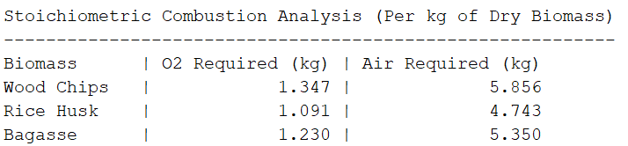
Matlab Calculation Results for other Bio-Masses
Matlab Code Attached In The Report

Slide 13
HHV & LHV Adjustment for Moisture (As-Received Basis)
If the moisture content is known (M, in %):
HHV_{ar} = HHV_{dry} * (1 - M/100)
LHV_{ar} = LHV_{dry} * (1 - M/100)
Notes:
Dry Basis
Laboratory value with 0% moisture
M
Moisture Content
% of water in the biomass sample
Example
If a biomass has 20% moisture (M = 20):
→ So only 80% of the dry energy is actually usable, because 20% of the fuel is just water.
Ar as require

Slide 14
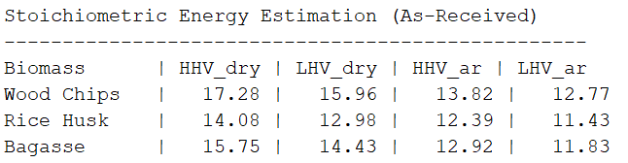
Matlab Calculation Results for HHV & LHV Adjustment
Matlab Code Attached In The Report

Slide 15
Real-World Biomass Conversion Efficiencies

Slide 16

The Typical values used
Wood Chips: 28%
Rice Husk: 22%
Bagasse: 25%
Source: International assessments by IRENA, ETSAP, and IEA Bioenergy
Common efficiency range 20% – 30% which is based on:
Feedstock quality
Moisture content
Combustion method

Slide 17
Key-loss Factors
Moisture evaporation
Unburned carbon
Flue gas heat losses
Result: Actual usable energy is much lower than the theoretical LHV (~11–13 MJ/kg)

Slide 18
Energy Losses in Real Systems
25-28%
72-75%
0%
100%
0%
100%
Energy Conversion rate
Energy Loss
Represents the actual usable energy output from biomass (e.g., 25% for bagasse, 22% for rice husk).
Over 70% of energy is lost during combustion and heat transfer due to moisture and system inefficiencies.

Slide 19
Visualization & Comparisons
Charts and Outputs

Slide 20
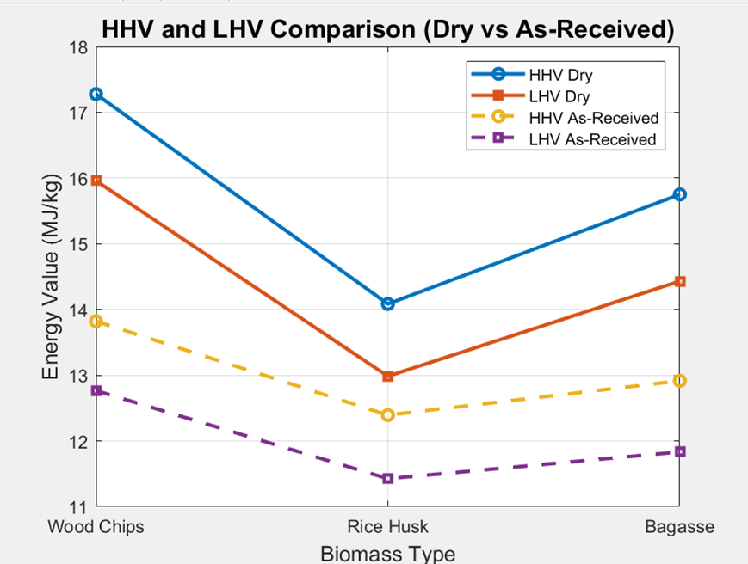

Slide 21
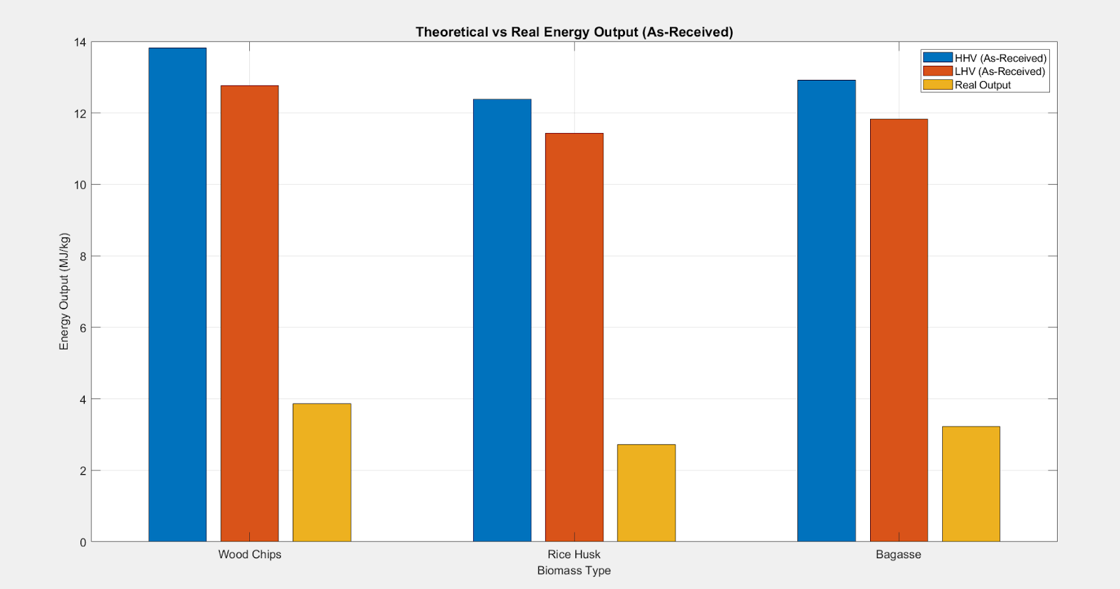

Slide 22
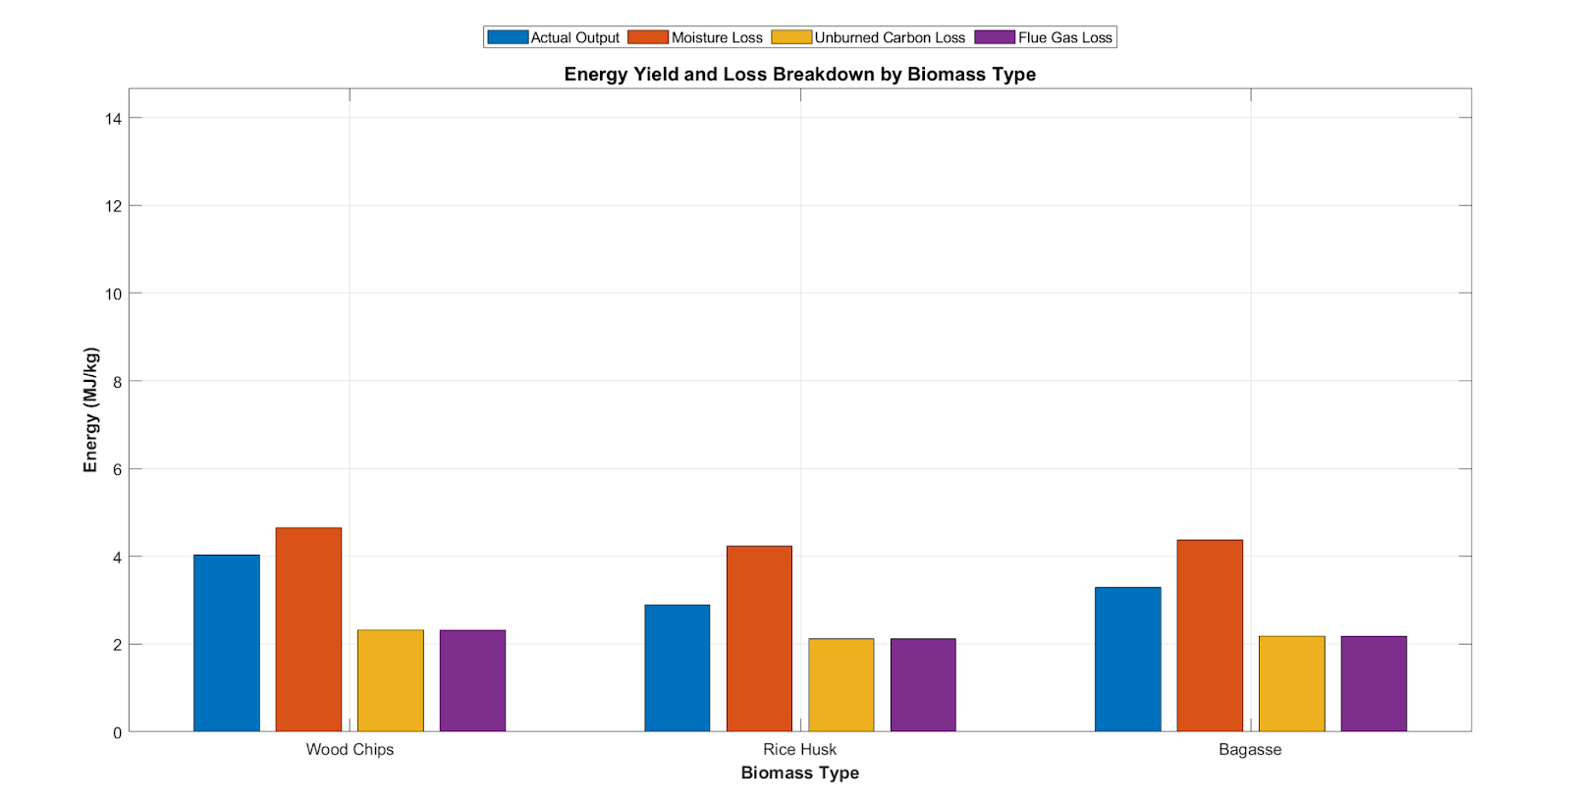
Energy Loss Distribution in Biomass Combustion Systems

Slide 23
Energy Loss Distribution in Biomass Combustion Systems
Loss Components:
Moisture Evaporation – highest loss across all types
Unburned Carbon – due to incomplete combustion
Flue Gas Heat – heat escaping with exhaust gases
Insights:
Pre-drying biomass can significantly reduce moisture losses
Smaller losses from carbon and flue gases → potential for optimization
Highlights the gap between theoretical and real efficiency

Slide 24
Takeaway
Effective combustion control + fuel preparation are key to improving output

Slide 25
Economic Perspective
Understanding energy efficiency losses helps reduce fuel costs per kWh.
Notes:
🎤 Speaking Content: Economic Perspective
Now let’s look at the economic angle of biomass energy systems.

Slide 26
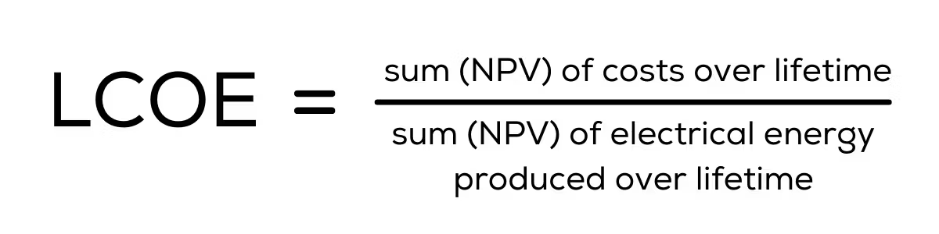
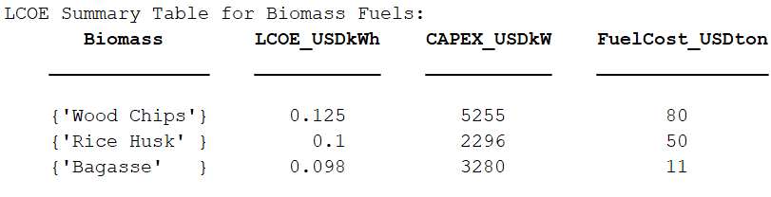
LCOE Calculations (Levelized Cost of Electricity)
Matlab Code Attached In The Report
Bagasse: $0.098/kWh
Rice Husk: $0.100/kWh
Wood Chips: $0.125/kWh
Notes:
The Levelized Cost of Electricity (LCOE) varies significantly depending on the type of biomass used:
For Bagasse, the LCOE is approximately $0.098 per kWh,
Rice Husk stands at $0.100 per kWh,
And Wood Chips are the most expensive at $0.125 per kWh.
These values are influenced by both fuel cost and plant efficiency. While bagasse offers only moderate energy yield, its low cost and wide availability make it the most economically viable option among the three.

Slide 27
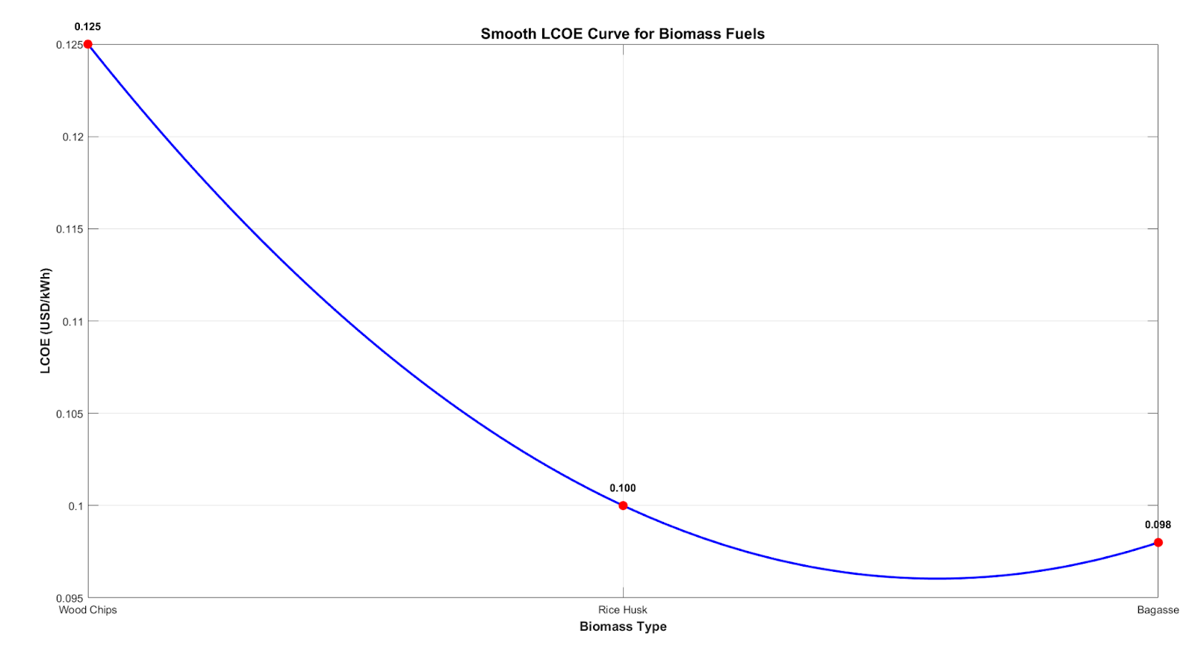
LCOE Calculations (Levelized Cost of Electricity)
Notes:
This bar chart compares the Levelized Cost of Electricity for three different biomass feedstocks: bagasse, rice husk, and wood chips.
As shown, bagasse has the lowest LCOE at $0.098 per kilowatt-hour. This makes it the most cost-effective option, mainly because it’s a low-cost byproduct of the sugar industry and doesn’t require much preprocessing.
Rice husk comes next at $0.100 per kWh. Although it's an agricultural waste and widely available, its higher ash content and lower energy density slightly raise its processing cost.
Wood chips are the most expensive, with an LCOE of $0.125 per kWh. This is due to their higher procurement and transportation costs, especially in regions where wood isn’t locally abundant.
What this graph really emphasizes is that feedstock selection has a major impact on the economics of biomass power. Even if two fuels have similar energy content, differences in supply chain cost, moisture content, and availability can make one far more viable than the other.”

Slide 28
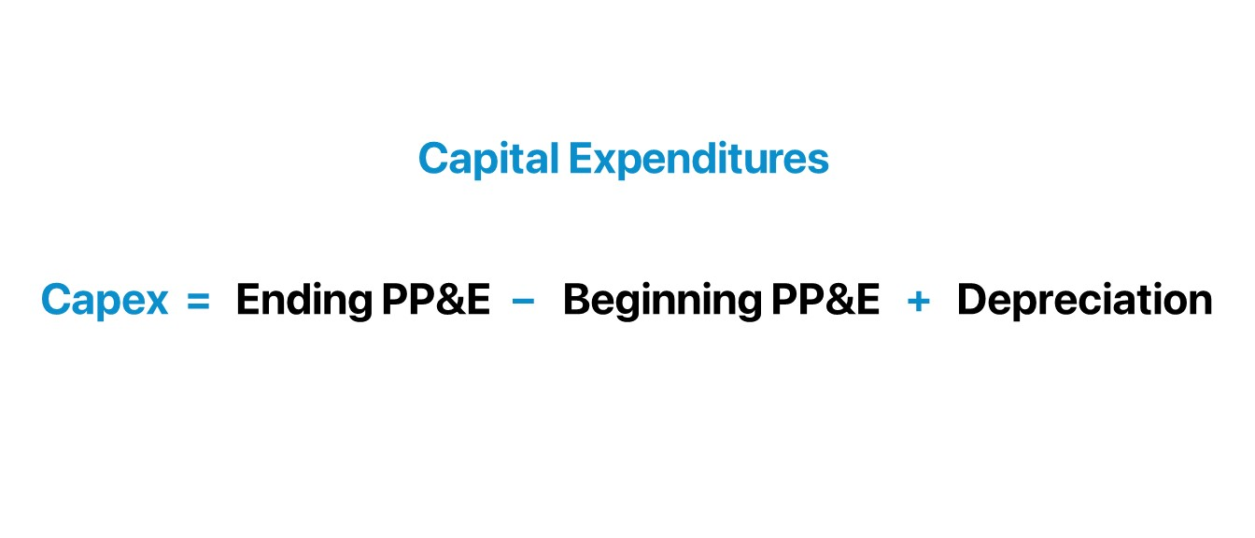
CAPEX (Capital Expenditures)
Wood Chips: $5,255/kW
Bagasse: $3,280/kW
These values are based on cost data from biomass power plant case studies and technology reports, such as: IRENA-ETSAP: Technology Brief E05 – Biomass for Heat and Power
NREL’s Cost and Performance data sheets
Notes:
In terms of Capital Expenditure (CAPEX):
A bagasse-based plant costs about $3,280 per kW installed,
Compared to $5,255 per kW for wood chips.
This clearly shows how feedstock selection directly impacts both the operating and capital costs, and ultimately, the ROI of a biomass project.

Slide 29
Findings
Bagasse = most cost-efficient due to low fuel cost and decent efficiency

Slide 30
249,867
kWh/year from a small-scale rice husk biomass plant
Notes:
Total energy input/day:
1000 kg × 12.39 MJ/kg = 12,390 MJ/day
Useful energy output/day (at 22% efficiency):
12,390 × 0.22 = 2,725.8 MJ/dayz
Convert MJ to kWh:
1 kWh = 3.6 MJ
2,725.8 MJ/day ÷ 3.6 = 757.17 kWh/day
Annual energy output:
757.17 × 330 days = 249,867 kWh/year

Slide 31
12,390 MJ/day
3,097 MJ/day
What we expect from stoichiometric combustion of 1 ton of rice husk
What’s actually delivered after real-world losses (25% efficiency)

Slide 32
From Feedstock to Functional Power
01
Awareness stage
Learn about biomass
02
Interest stage
Interest in specific feedstocks
03
Consideration stage
Tech and Feasibility studies
04
Decision stage
Decide on technology and scale
05
Conversion stage
Implement the biomass Plant

Slide 33

Real Life Applications
Biomass Power Plants
Used for rural electrification and industrial heat generation, especially in India, Brazil, and the U.S.
Technologies: direct combustion, co-firing, gasification, combined heat and power (CHP) units.
Notes:
Biomass energy isn’t just a theory—it’s already being applied globally in several impactful ways:
Biomass Power Plants
These are widely used in countries like India, Brazil, and the U.S.,
Especially in rural electrification and industrial heat generation.
Technologies include direct combustion, co-firing, gasification, and CHP systems.
Municipal Solid Waste (MSW) Combustion
Urban waste is processed in incineration plants to recover energy while also reducing landfill volumes.
This method serves both energy generation and waste management goals.

Slide 34

Real Life Applications
Agricultural Waste-to-Energy Systems:
Conversion of rice husk, sugarcane bagasse, coconut shells, etc., into electricity and bioheat.
Notes:
Agricultural Waste-to-Energy Systems
In regions with large agro-industrial activity, residues like rice husk, bagasse, and coconut shells are being converted into both electricity and useful heat.

Slide 35
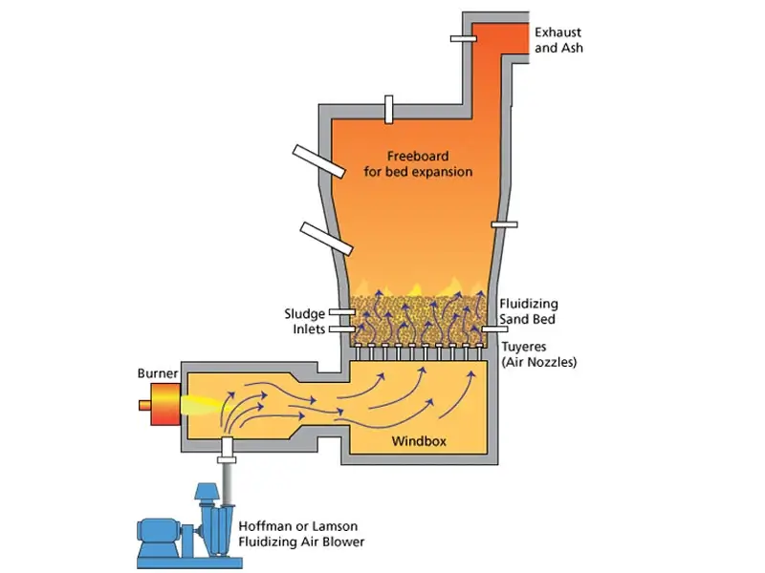
Real Life Applications
Municipal Solid Waste (MSW) Combustion
Integration with waste management systems to produce energy and reduce landfill volumes.
Notes:
Municipal Solid Waste (MSW) Combustion
Urban waste is processed in incineration plants to recover energy while also reducing landfill volumes.
This method serves both energy generation and waste management goals.

Slide 36
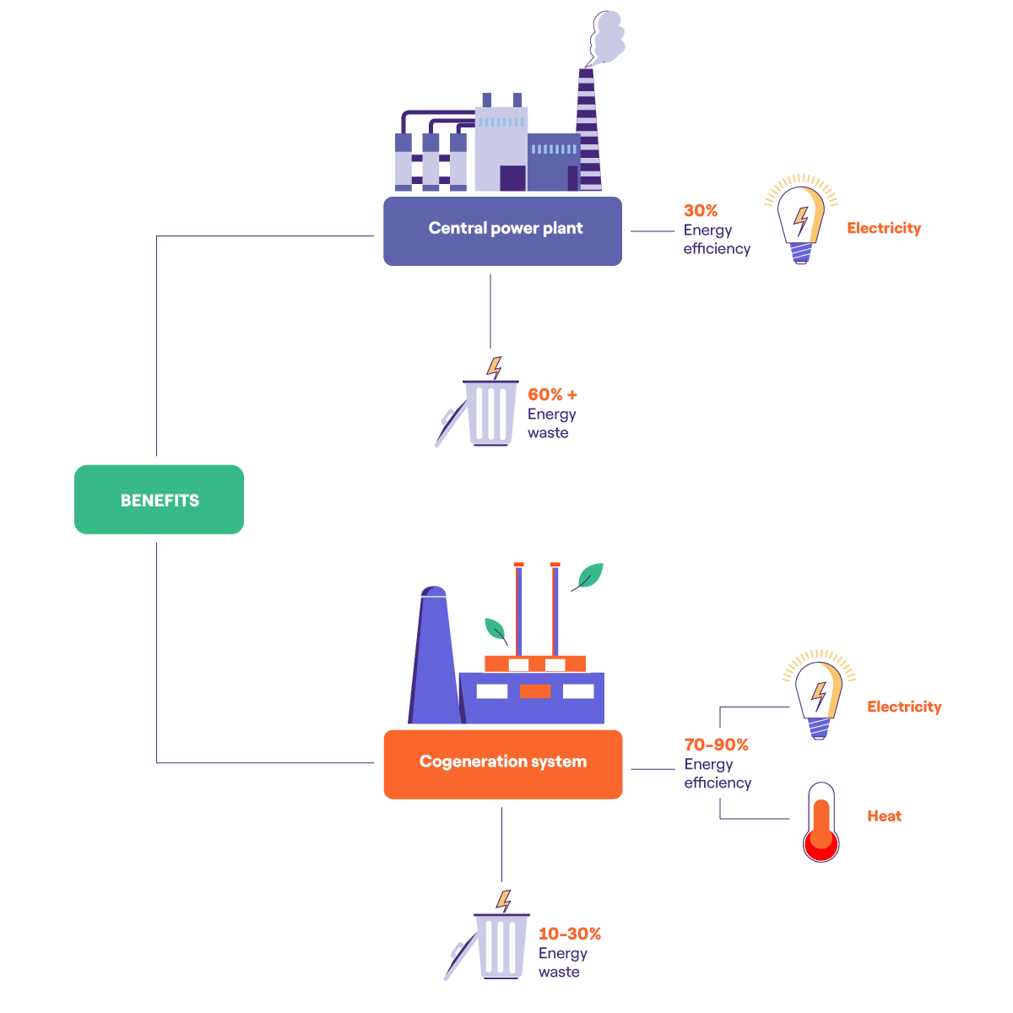
Real Life Applications
Cogeneration Systems
Biomass-powered cogeneration is common in sugar mills and paper industries, increasing total efficiency to over 60%.
Notes:
Cogeneration Systems
Common in sugar mills and paper factories, cogeneration using biomass can push total plant efficiency to over 60%, as it produces both electricity and heat simultaneously

Slide 37

Real Life Applications
District Heating Systems (Europe)
Biomass-fueled community heating plants for residential and commercial use.
Notes:
District Heating Systems
In European countries, biomass-fueled plants are used to heat entire neighborhoods or small towns, offering a sustainable and local solution for thermal energy needs

Slide 38

Conclusion and Future Scope

Slide 39

Conclusion
Theory vs. actual output shows large gap (due to real-world losses)
Moisture and unburned carbon = major inefficiencies
Bagasse emerges as best option (low cost, good performance)
Optimization through drying and smart controls improves ROI
Study supports better feedstock and system design choices
Notes:
In conclusion:
There's a clear gap between theoretical and actual output, mainly due to real-world inefficiencies.
Moisture and unburned carbon are major loss contributors.
Among the options, bagasse performs best—it’s both cost-effective and efficient.
Drying and smart controls can help improve energy recovery and ROI.
Overall, this study supports smarter feedstock selection and system optimization for better biomass energy systems."

Slide 40

Future Scope
Advanced Drying Techniques:
Use of solar or waste heat dryers to reduce feedstock moisture and increase net energy output.
AI-Powered Combustion Control:
Real-time optimization of combustion conditions using sensors and machine learning to minimize unburned carbon.
Hybrid Systems (Biomass + Solar):
Integrating solar PV or thermal with biomass plants for stable, round-the-clock renewable power.
Notes:
Looking ahead, there are some exciting ways to improve biomass systems.
First, using solar or waste heat for drying feedstock can significantly improve energy output.
Next, integrating AI for real-time combustion control can reduce unburned carbon and make the system smarter.
And combining biomass with solar in hybrid systems can ensure reliable, round-the-clock clean energy.

Slide 41
Future Scope
Decentralized Microgrids:
Village-scale biomass units for off-grid electrification, especially in agricultural regions.
Biochar Co-Production:
Generating biochar alongside energy to enhance soil health and sequester carbon.
Carbon Credits & CDM Programs:
Leveraging Clean Development Mechanism (CDM) and voluntary carbon markets to improve project viability.
Waste-to-Energy Expansion:
Adapting MSW combustion technologies for urban waste management with energy recovery.
Notes:
On a broader scale, biomass can power decentralized microgrids—especially useful in rural areas.
We can also produce biochar along with energy, which helps in carbon sequestration and soil health.
By leveraging carbon credit markets and CDM programs, we can improve project economics.
And finally, expanding into waste-to-energy can help manage urban waste while generating power.

Slide 42

Thank you all!

Slide 43
Data Sources (References)
Sources | Type of Data
NREL Biomass Data | Ultimate analysis, HHV/LHV, moisture content
IEA Bio-energy Reports | Efficiency benchmarks, plant logs
US EIA Reports | Biomass generation stats
Peer-Review Papers | Real plant performance, combustion efficiency
Literature (e.g., Jenkins et al., 1998) | Biomass combustion characteristics
Links in attached in the report

